Slide 1
“Salesmen Performance Analysis for WanderOn Experiences Pvt. Ltd.” By Hemant Gupta

Slide 2
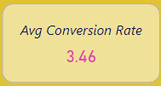
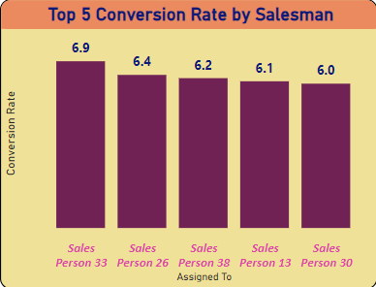
Top 5 Conversion Rate by Salesmen 3.46% Conversion Rate: This is a critical metric that shows the percentage of leads that have been successfully converted into sales. An average conversion rate of 3.46% suggests that out of every 100 leads, approximately 3 to 4 are converted into sales. High Skill Level: The top 5 salesmen have demonstrated high conversion rates, signifying that they possess superior sales skills. Conclusion- While the current average conversion rate of 3.46% provides a baseline for performance, there is a clear opportunity to enhance sales outcomes through targeted training and performance optimization. Utilizing the skills of top performers to train the broader team could be a key strategy in improving the overall conversion rates, thus boosting sales effectiveness and revenue.

Slide 3
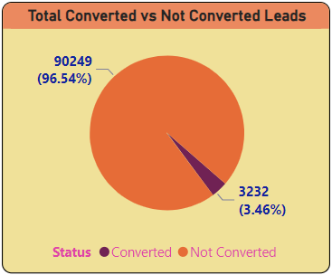
Total Converted Vs Not Converted Leads Converted vs. Not Converted Leads: The donut chart provides a clear visual representation of the conversion efficiency. Converted Leads (3.46%): This segment is relatively small, indicating that a vast majority of leads are not being converted. Not Converted Leads (96.54%): This large segment represents a significant opportunity for improvement. Reducing this percentage by even a small margin could lead to substantial increases in total sales. Conclusion- Focus on developing comprehensive training programs and Conduct regular reviews of conversion rates to identify trends and areas needing improvement.

Slide 4
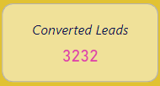
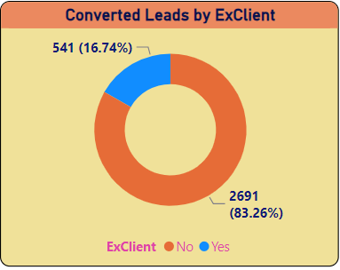
Converted Lead by Ex-Client With 16.74% of the converted leads being excellent, it shows that a significant portion of the sales conversions are of high quality. This could mean these leads are either high-value customers, have a high likelihood of repeat business, or have given positive feedback. Gathering feedback from the excellent leads can provide insights into what worked well and what can be replicated in future sales strategies. Conclusion: The data shows that out of 3232 converted leads, approximately 541 (16.74%) are categorized as excellent. This indicates a good level of quality in the sales process but also highlights an opportunity for improvement. By focusing on enhancing lead qualification, providing targeted training, and leveraging customer feedback, the sales team can aim to increase both the number and quality of conversions, driving better overall sales performance.

Slide 5
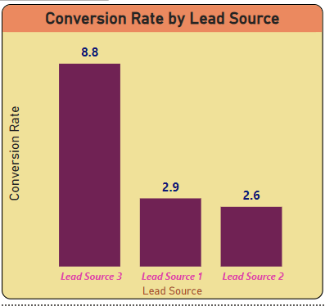
Conversion Rate by Lead Source The visuals highlights the conversion rates of different lead sources, identifying Lead Source 3 as having the highest conversion rate and Lead Source 2 as having the lowest. Conduct a detailed analysis of Lead Source 3 to understand why it is performing well. Similarly, analyze Lead Source 2 to identify the factors contributing to its low performance. This could involve reviewing the quality of leads, the sales process, and the alignment with the target market. Conclusion- The visual data indicating that Lead Source 3 has the highest conversion rate and Lead Source 2 has the lowest provides clear direction for strategic adjustments. Focusing on enhancing successful strategies for Lead Source 3.

Slide 6
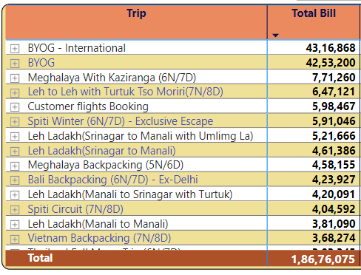
Top Destinations by Total Bill Identifying the destinations with the highest total bills can help in understanding customer preferences, high-demand areas, and potential growth. Collect feedback from customers who have traveled to the top destinations to understand what they value most. Use this information to enhance the customer experience. Conclusion- Analyzing the top destinations based on total bill provides valuable insights into revenue generation, customer preferences, and potential areas for strategic investment. By focusing on enhancing high-revenue destinations, optimizing underperforming areas, diversifying offerings, and leveraging customer feedback, businesses can improve overall profitability and customer satisfaction.

Slide 7

Thank You

